Slide 1

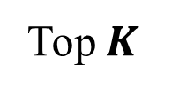



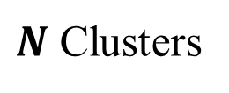
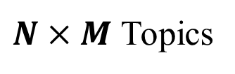






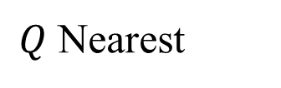
Corpus: Review Sentences
Sentence Vector
Representation
……
Word Vector
Representation
Mined Quality Phrases
……
……
Sentence Clustering
Phrase Word Vector Composition
…..
$N$ Clusters
…..
…..
…..
Aspect Words & Phrases
Word & Phrase Vectors
……
$$A_{1}:W_{11}, W_{12}…,W_{1Q}$$
$$A_{2}:W_{21}, W_{22}…,W_{2Q}$$
$$A_{3}:W_{31}, W_{32}…,W_{3Q}$$
$$……$$
$$A_{K}:W_{K1}, W_{K2}…,W_{KQ}$$
Topic Modeling
$$M$$
$$M$$
$$M$$
$Q$ Nearest
…
…
…
…..
$K$ Aspects
Aspect Vector (AspVec)
$N×M$ Topics
Topic Clustering
Legend:
…
…
…..
…
Word Vector Aggregation
Word Vector:
Word Weighting
Sentence Vector:
$C$ Clusters
Topic Pooling
…..
$K$ Aspects
Aspect Word Distribution
Phrase:
Sort by score
Top $K$
Topic:
Topic Clusters Ranking
>
>
…..
>
Aspect Vector:
$$S_{1}$$
$$S_{2}$$
$$S_{C}$$

